Slide 1

Team 8 Travel alone
12301107 王俊猛
12301103 刘 嵩
12301097 郭斯滕

Slide 2

Content:
1:Orientate of the APP
2:Use story
3:introduction of the app

Slide 3

For what
The App is mainly for the persons who like traveling around. It’s convenient for them to write the articles to share their emotions with others. Also, they can feel what others feel.
Besides, the App could locate where you are and report to the person whom you want to know.
For whom
the app is for the people who like outdoors and usually travel alone.

Slide 4
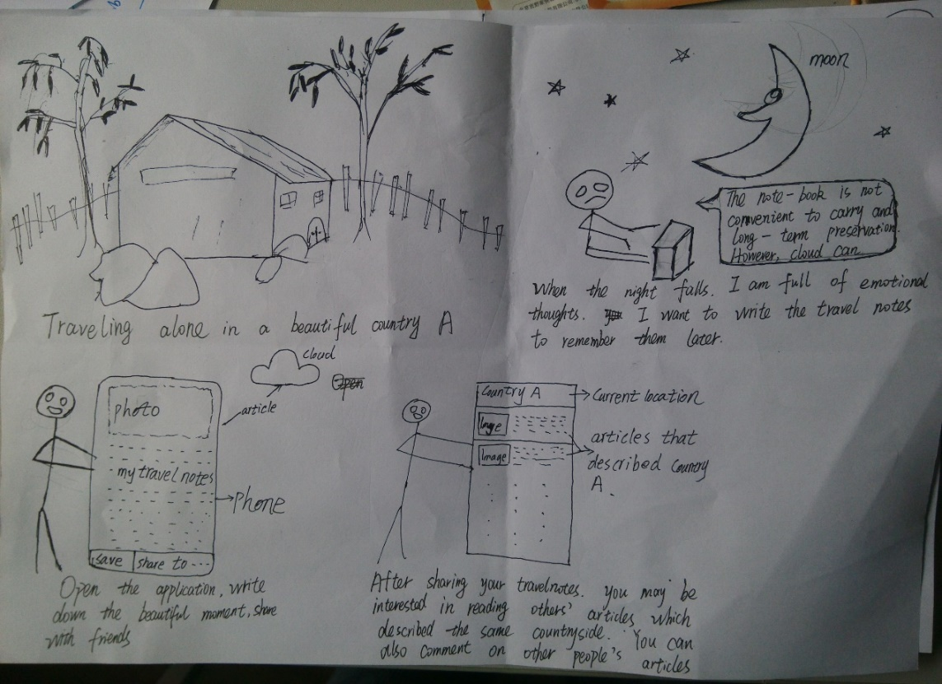
Use story:
When we are traveling, the views always impress us. Touched, moved, we want to remember that. However, our memory could betray or lie to us.
So the best way is to write it down. Then, Where?
Here we are. We have everything you need. Even, we have more. We can not only let you write these things down, but also read others’ articles to have some emotions in common.

Slide 5
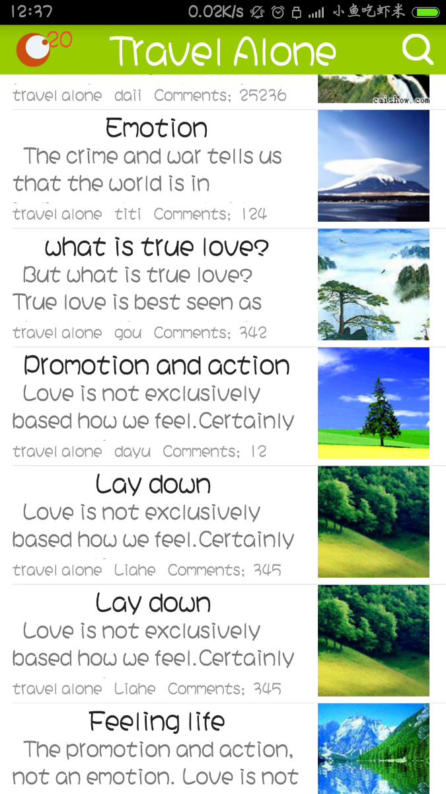
The brief introduction of the app
This is the main page. In this page, we could read the title and the picture. Besides, we also could see a part of the article. Including some other information like the number of the praise.

Slide 6

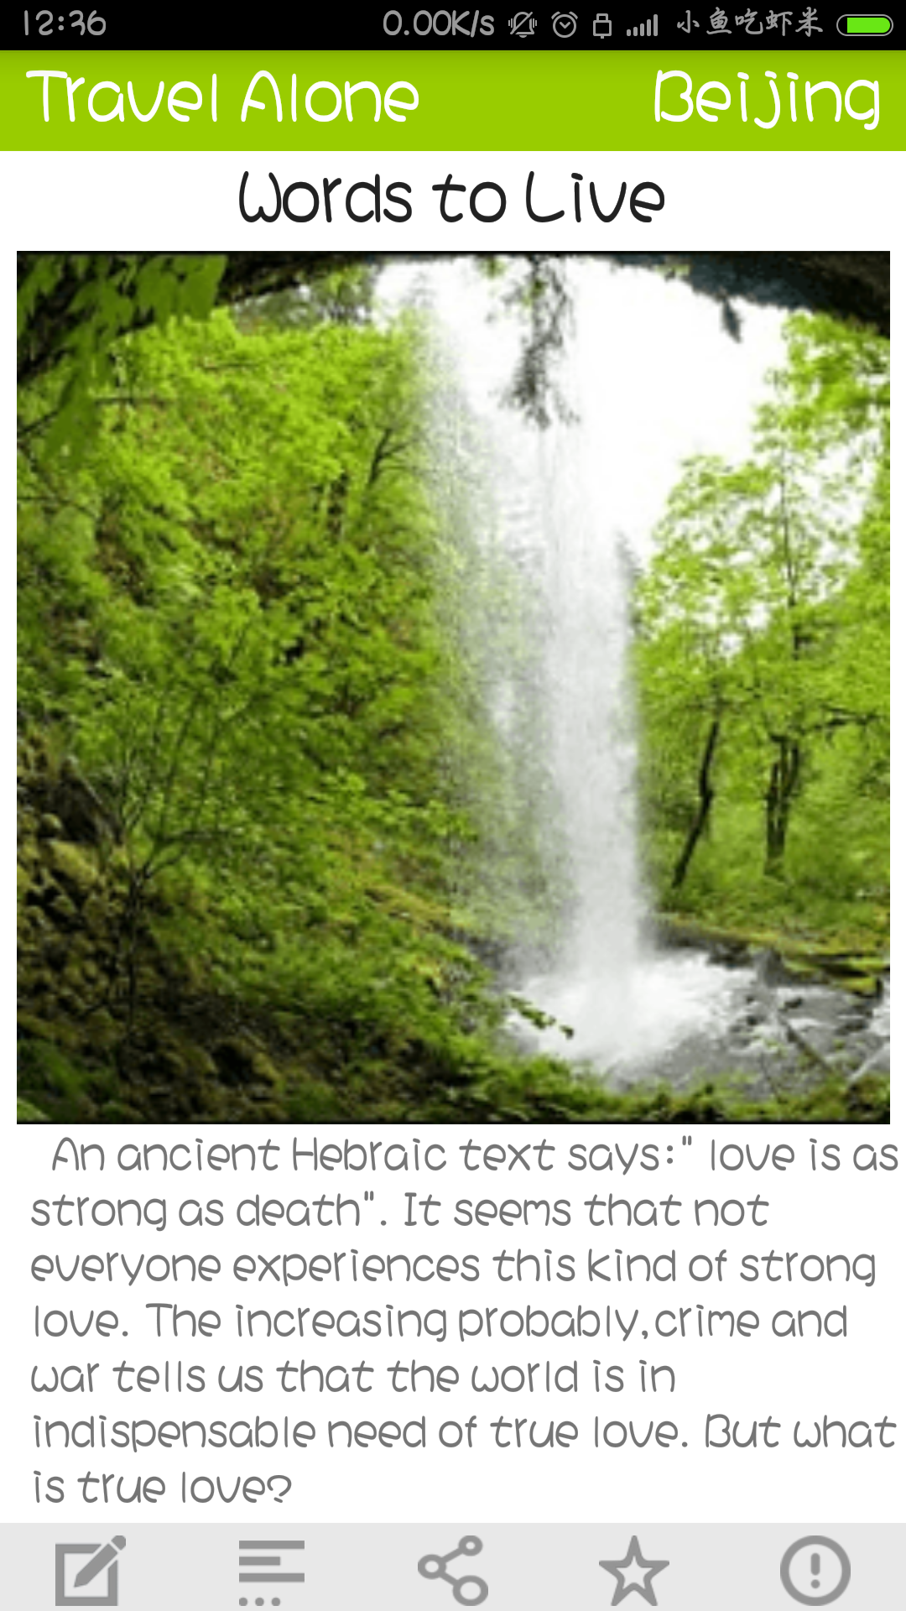
This is the specific article. You could read it and feel the emotions in it .
Also, there are some buttons in the bottle ,which you could operate.

Slide 7
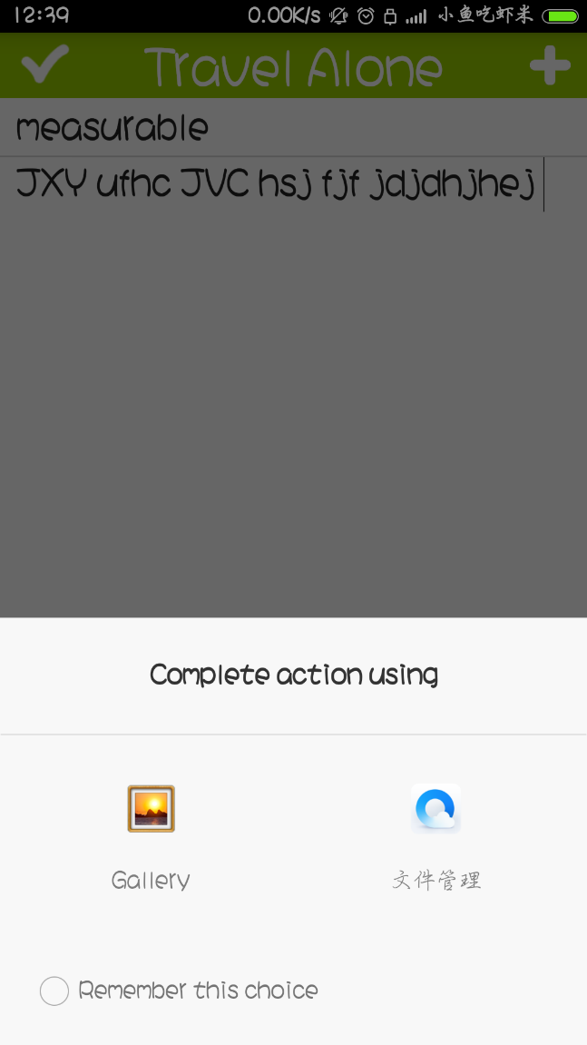
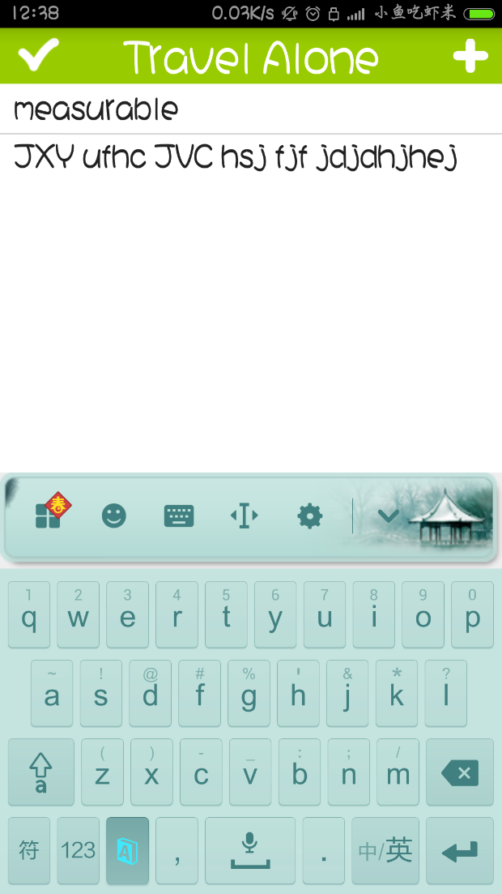
These are writing the articles and upload the pictures

Slide 8
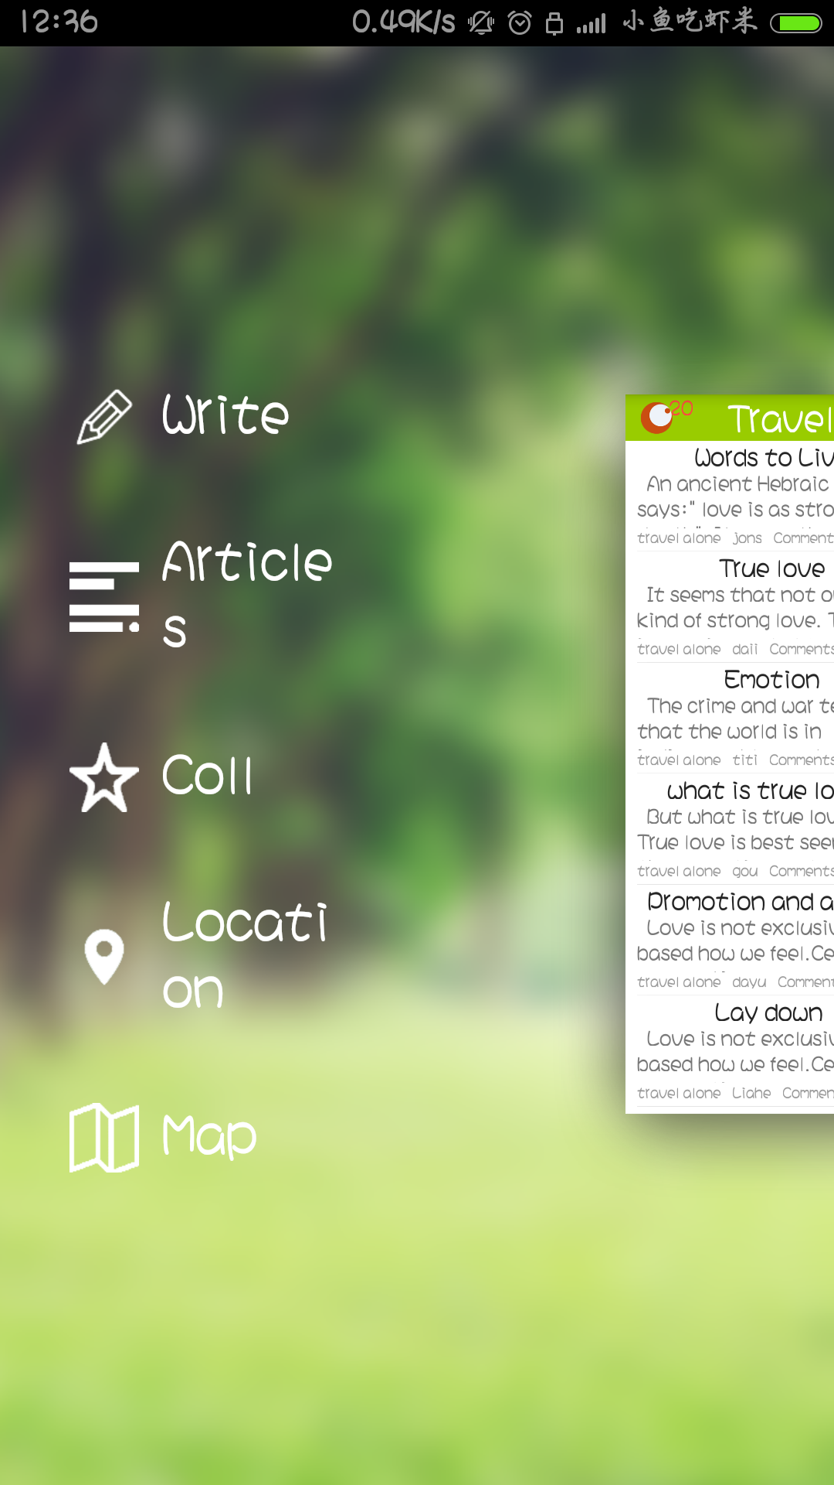
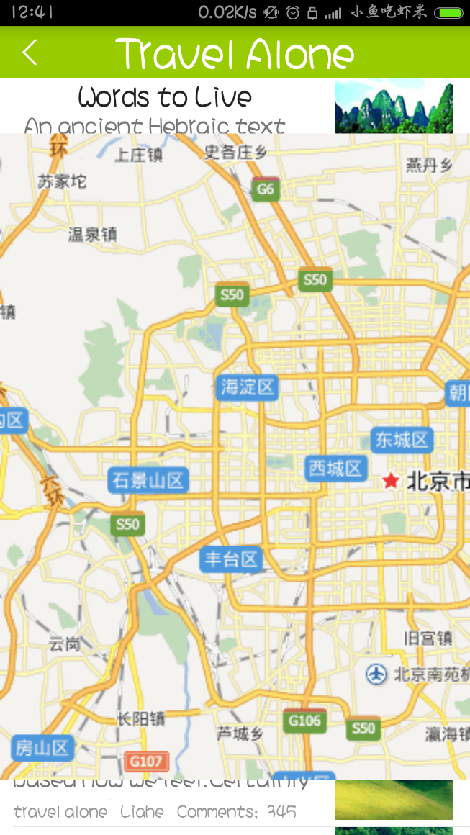
menu
Map

Slide 9
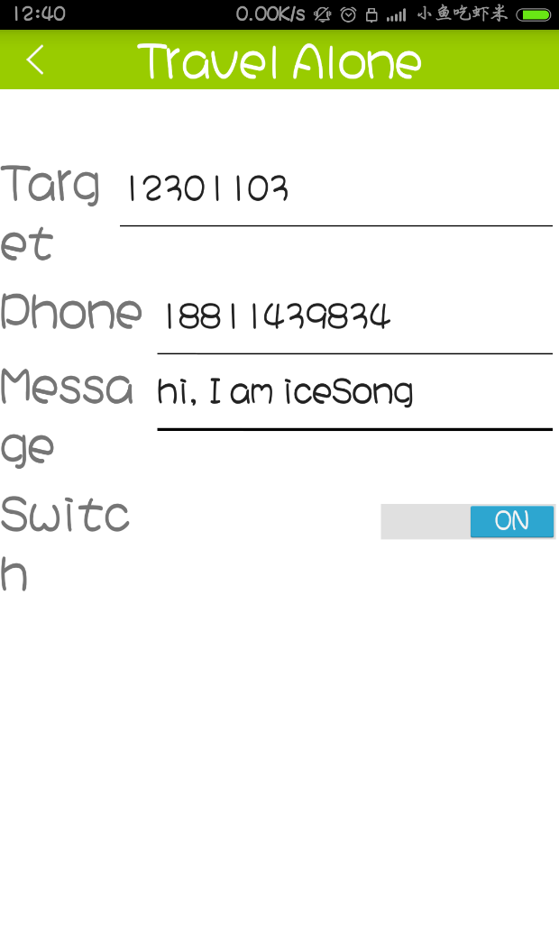
Record
the
message
Send to
the
special person

Slide 10
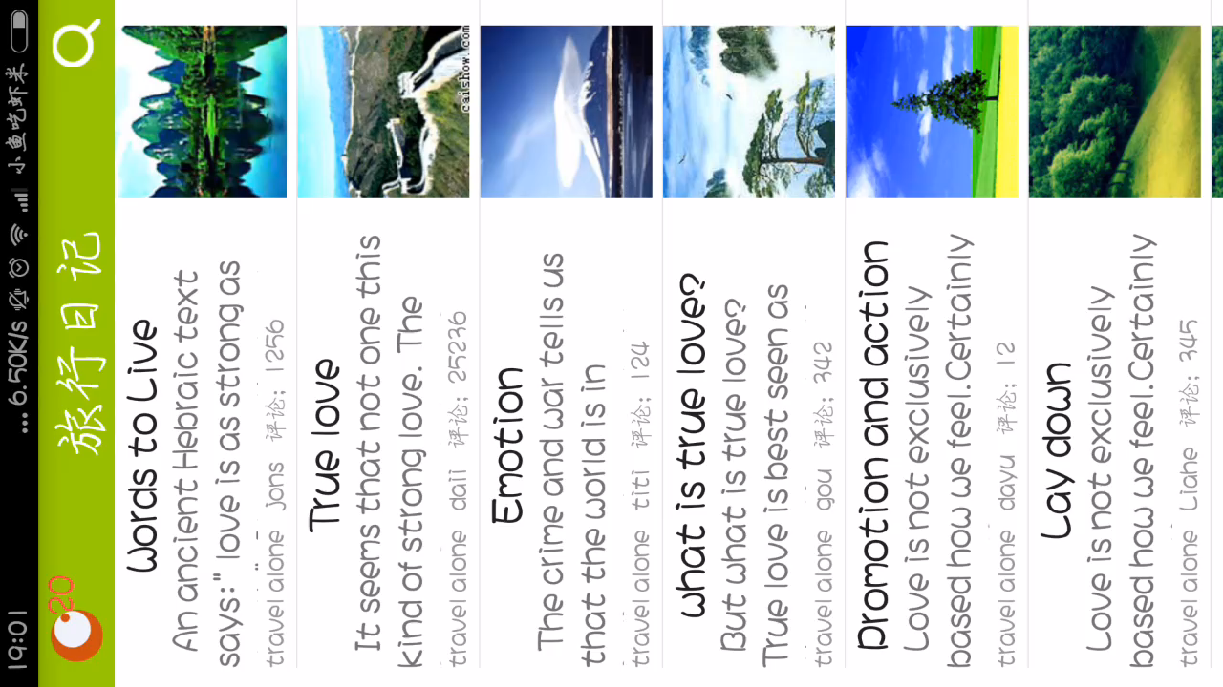
We also prepare a video
And
here it is

Slide 11
Thank
You

